Slide 1

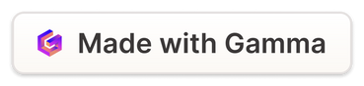
Unveiling the Web's Interworking Terms & Concepts
Welcome! This presentation will delve into the essential terms and concepts that underpin the World Wide Web. We'll explore the key components that make the internet function seamlessly, from the fundamental building blocks to the technologies that power the web we use every day. Get ready to unravel the mysteries of the digital world.
Notes:
1

Slide 2
The World Wide Web (WWW)
Definition
Key Features
The World Wide Web, commonly known as the WWW or simply the Web, is a system of interlinked hypertext documents accessed via the Internet. It's essentially a vast collection of web pages linked together, allowing users to navigate effortlessly through a sea of information.
The WWW is characterized by its hypertext nature, allowing users to jump between pages seamlessly using links. It's also a distributed system, with information residing on various servers around the globe, accessible to anyone with an internet connection.
Notes:
2

Slide 3

WWW Attributes and Components
1
Hypertext
2
Protocols
The foundation of the WWW is hypertext, allowing users to click on links within a document to jump to other related documents or locations on the web.
The WWW relies on various protocols, including HTTP (Hypertext Transfer Protocol), for communication between servers and browsers. These protocols define the rules for data exchange.
3
Servers
4
Clients
Web servers store and deliver web pages to users. They respond to requests from browsers, providing the requested content.
Web clients, typically web browsers, request and display web pages. They interpret the HTML code and present the information to the user.
Notes:
3

Slide 4
Telnet and A Sample Telnet Session
Telnet
Sample Session
Telnet, a networking protocol, allows users to connect to remote computers and interact with them remotely, using a text-based interface. It's often used for administrative tasks or accessing services on other machines.
user@host:~$ telnet www.example.com 80
Trying 192.168.1.1...
Connected to www.example.com.
Escape character is '^]'.
GET / HTTP/1.1
Host: www.example.com
HTTP/1.1 200 OK
Date: Mon, 23 Oct 2023 18:28:12 GMT
Server: Apache/2.4.53 (Ubuntu)
Content-Length: 127
Content-Type: text/html; charset=UTF-8
...
Notes:
4

Slide 5
Web Browsers and Web Servers
Web Browsers
Web Servers
Web browsers, like Chrome, Firefox, and Safari, act as the user interface for accessing the WWW. They receive and interpret HTML code from servers and present the content visually. They also handle user interactions, such as form submissions and navigation.
Web servers, like Apache and Nginx, are responsible for storing and delivering web pages. They respond to requests from browsers, providing the requested content and ensuring the smooth functioning of websites.
Notes:
5

Slide 6
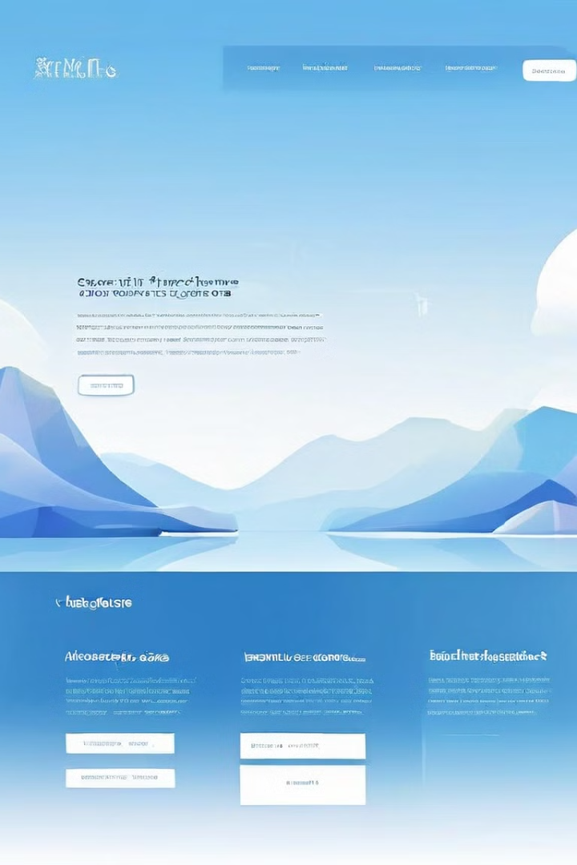
Web Sites, Web Addresses, and Web Pages
Web Sites
Web Addresses
A website is a collection of interconnected web pages, typically organized around a specific theme or purpose. Websites can be informational, commercial, or social, providing various content and services to users.
Web addresses, or URLs (Uniform Resource Locators), are unique identifiers for web pages. They tell web browsers where to find specific content on the internet.
Web Pages
Web pages are individual documents that make up a website. They're typically written in HTML and contain text, images, videos, and other multimedia content.
Notes:
6

Slide 7
URLs and Domain Names
URLs
Domain Names
URLs, or Uniform Resource Locators, are the addresses used to access resources on the WWW. They contain information like the protocol, domain name, path, and query parameters.
Domain names are user-friendly representations of IP addresses. They're the part of the URL that's easy to remember and identify a specific website, such as 'google.com' or 'facebook.com'.
Notes:
7

Slide 8



DNS and DNS Servers
DNS Servers
DNS
DNS servers are responsible for storing and providing domain name resolutions. When a browser requests a website, the DNS server looks up the corresponding IP address and directs the browser to the correct server.
The Domain Name System (DNS) acts as the phonebook for the internet, translating human-readable domain names into machine-readable IP addresses.
Notes:
8

Slide 9




Web Page Development: The Languages of the Web
HTML
1
The foundation of web pages, HTML defines the structure and content of a web page.
XML
2
Used for data exchange and storage, XML provides a structured way to define data formats and ensure consistent data representation.
DHTML
3
A combination of HTML, CSS, and JavaScript, DHTML allows for interactive and dynamic web pages with improved user experiences.
Web Scripting
4
Languages like JavaScript, Python, and PHP are used for adding dynamic behavior and functionality to web pages, making them interactive and responsive.
Notes:
9

Slide 10
Networking Security Concepts and Protection Methods
1
Firewalls
Firewalls act as security barriers, filtering network traffic and blocking unauthorized access to devices and systems.
Antivirus Software
2
Antivirus programs detect and remove malicious software, protecting devices from viruses, worms, and other threats.
Strong Passwords
3
Using strong passwords, consisting of a combination of upper and lowercase letters, numbers, and special characters, makes it difficult for hackers to guess passwords.
Security Awareness
4
Being aware of potential threats, like phishing emails and malicious websites, can help users avoid falling victim to cyber attacks.
Notes:
10

